Slide 1
ON THE SPOT DELIVERY
RELEASE 2 PRESENTATION

Slide 2
SPRINT 3 RECAP
What was added in Sprint 3:
Driver Management Page
Package Pickup Form
Package Check in Form
Package Delivery Form
Driver Creation Page

Slide 3
SPRINT 4 USER STORIES
Story ID | Story Title | MoSCoW | Story Points
SRCX-42 | Operator Management Page | Must Have | 2
SCRX-96 | Order Confirmation Prompt | Could Have | 2
SCRX-142 | Log Time of Delivery Process | Could Have | 1
SCRX-18 | View Payment Information | Must Have | 2
SCRX-143 | Operator Creation Page | Should Have | 4
SCRX-141 | Package Tracking | Could Have | 4
 | Story Points Sub Total: |  | 15

Slide 4
ACCEPTANCE CRITERIA
Validated using a mixture of Automated Unit Tests and and Scripted Manual Tests
More details on tests in “Testing Outcomes and Acceptance Criteria.docx”

Slide 5
ACCEPTANCE CRITERIA
Operator Management Page
Web page should provide navigation to the order pickup, warehouse check in and order delivery pages
Web page should provide space to allow the addition of other features in the future
Only accessible by operators
Order Confirmation Prompt
Upon submitting an order, customer is prompted to confirm details of order

Slide 6
ACCEPTANCE CRITERIA
Log Time of Delivery Process
The time is automatically logged as the driver changes the status of orders
View Payment Information
Business operator can view details about unpaid orders
Clicking Process Payment will remove order from list of payments awaiting charge
Access restricted to operators only

Slide 7
ACCEPTANCE CRITERIA
Operator Creation Page
Operator is prompted to enter Company Username, First Name, Last Name and Driver Password
Upon creation of Driver, Driver is able to login using credentials
Package Tracking
Upon navigation to the page, status bars of various orders are visible
Clicking on an order will show more detailed time information

Slide 8
TIME ESTIMATES
Story ID | Title | Estimated | Actual
SCRX-42 | Operator Management Page | 13 hours | 14 hours
SCRX-96 | Order Confirmation Prompt | 11 hours | 12 hours
SCRX-142 | Log Time of Delivery Process | 5 hours | 9 hours
SCRX-18 | View Payment Information | 1 hour | 1 hour
SCRX-143 | Operator Creation Page | 27 hours | 26 hours
SCRX-141 | Package Tracking | 25 hours | 25 hours
Total |  | 82 hours | 87 hours

Slide 9
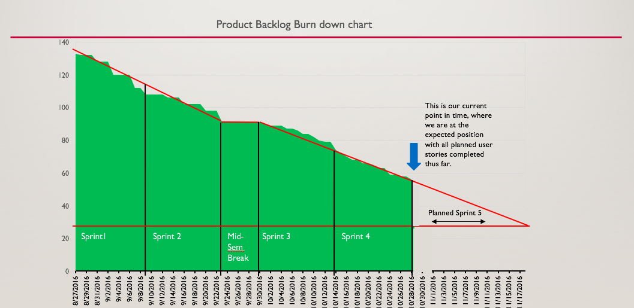
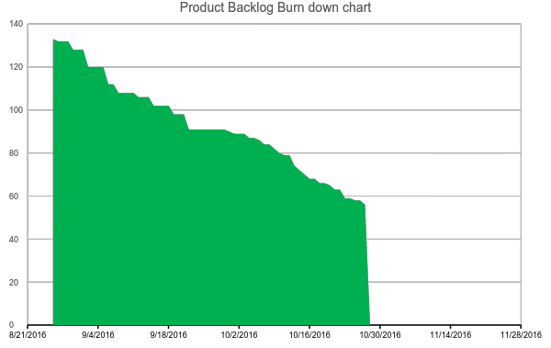
BURNDOWN CHART
This is our current point in time, where we are at the expected position with all planned user stories completed thus far.
Sprint1
Sprint 2
Mid-Sem Break
Sprint 3
Sprint 4
Planned Sprint 5

Slide 10
Velocity
Velocity at the end of Sprint One: 15
Velocity at the end of Sprint Two: 15
Velocity at the end of Sprint Three: 14.66
Velocity at the end of Sprint Four: 15.5

Slide 11


DEVELOPMENT FRAMEWORK
Ruby on Rails
MVC Design Pattern (Maintainable, scalable)
Ruby Unit Testing Framework (In-depth, multiple case unit tests)
Database migrations implemented
Heroku Production Server
Postgres database

Slide 12
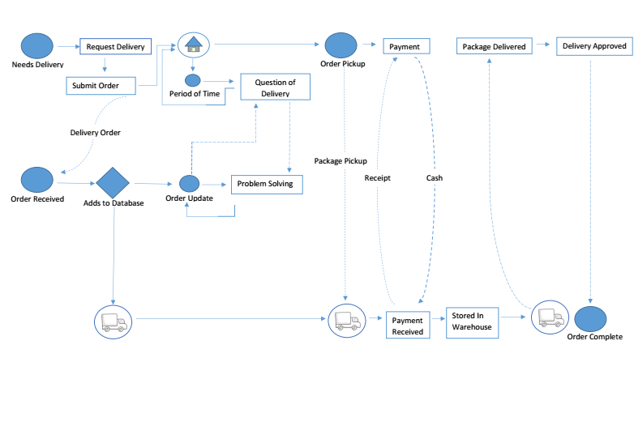
PACKAGE PROCESS MODEL

Slide 13
PRODUCT DEMONSTRATION
Demonstration will consist of 3 parts:
Operator / Manager Demo
Driver Demo
Customer Demo

Slide 14
SPRINT 5 AND FUTURE DEVELOPMENT
Story ID | Story Title | MoSCoW | Story Points
SCRX-6 | Generating Business Related Statistics | Could Have | 1
SCRX-26 | Customer Order History | Could Have | 2
SCRX-19 | Driver Roster | Could Have | 6
SCRX-8 | Manage Employed Drivers | Should Have | 2
SCRX-24 | Customer Favourite Recipients | Could Have | 4
 | Story Point Sub-Total: |  | 15

